Slide 1
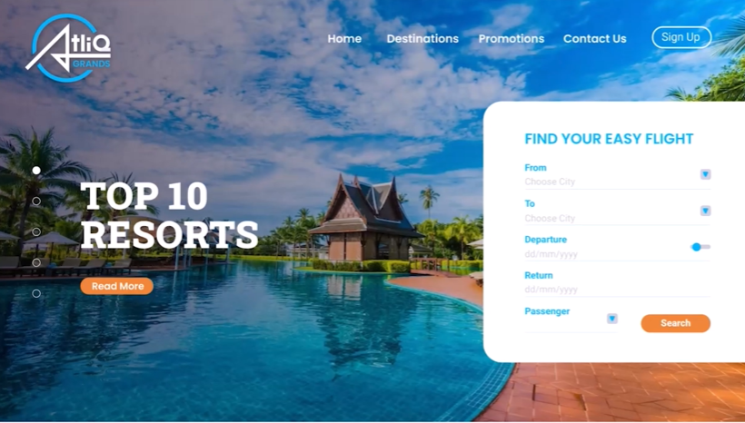

Slide 2
1
Understanding Business Problem
6
Mock-up Dashboard
2
Database & Data Warehouse info
7
Hospitality Main View
3
Data Collection & Understanding
8
Performance Analytics
4
Exploratory Data Analysis
9
Revenue Contributors
5
Data Transformation & Modelling
10
Insights Summary

Slide 3
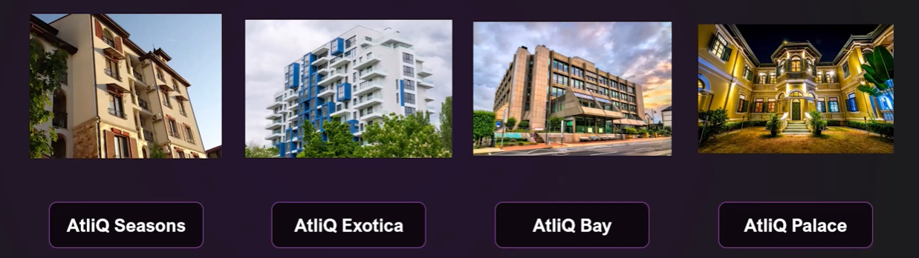
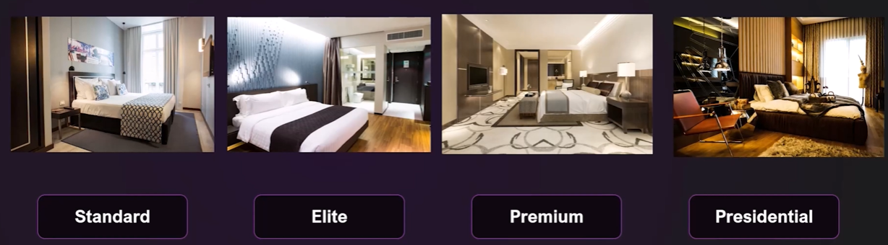
1
Understanding Business Problem
Properties
Room Class
1

Slide 4

1
Understanding Business Problem
Booking Platforms
📊Problem Statement :
AtliQ Grands, a renowned luxury hotel chain in India, is facing challenges in market share and revenue due to competition and management decisions. To counter this, the managing director seeks to leverage Business and Data Intelligence but lacks an in-house analytics team. As a data analyst, my task is to utilize sample data and a mock-up dashboard to:
Create specified metrics.
Develop a dashboard as per stakeholder requirements.
Generate additional insights beyond the given metrics and mock-up.
1

Slide 5
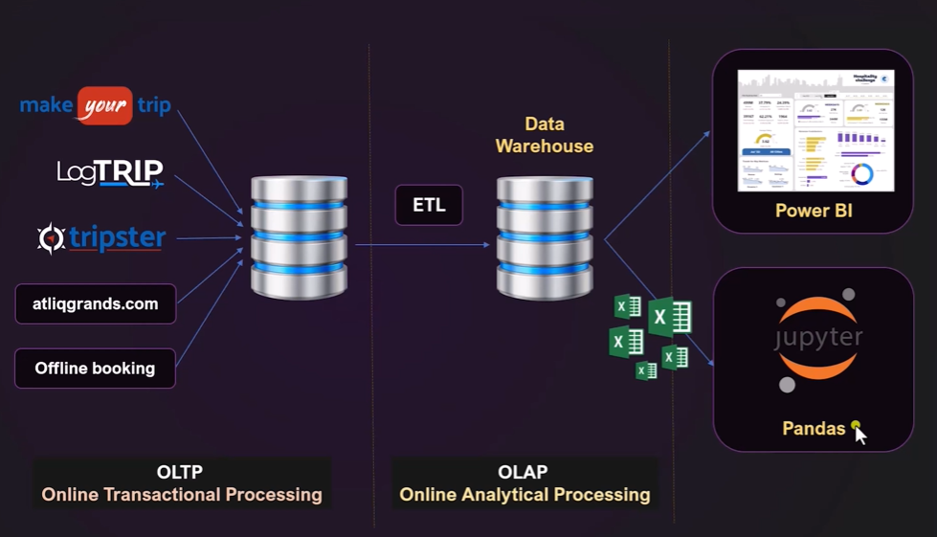
2
Data Base & Data Warehouse info
2

Slide 6



3
Data Collection & Understanding
Data Analyst
Data Engineer
Data Analysis
3

Slide 7
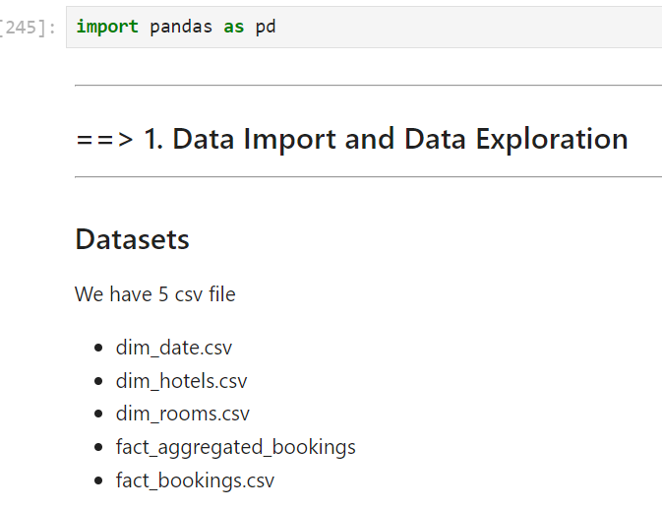
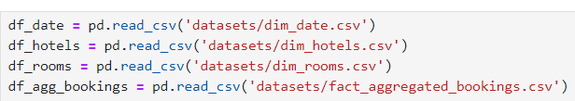
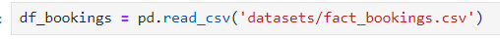
4
Exploratory Data Analysis
Data Analyst
Data Engineer
Data Analysis
Loading CSV Files in Jupyter Notebook
4

Slide 8
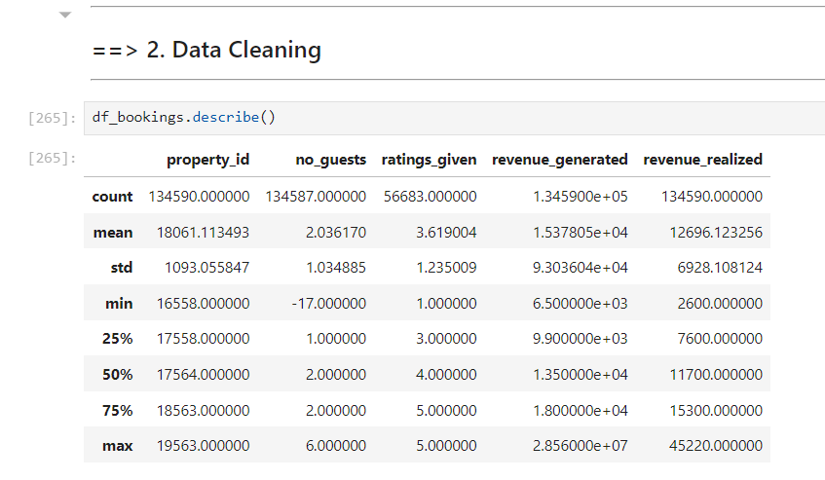
4
Exploratory Data Analysis
After running “ describe” function, the values in “no of Guests” column cannot be negative, this is an error, need to check how many more negative values are there and need to clean up.
To find out, how many rows & columns are there run “shape” function
4

Slide 9
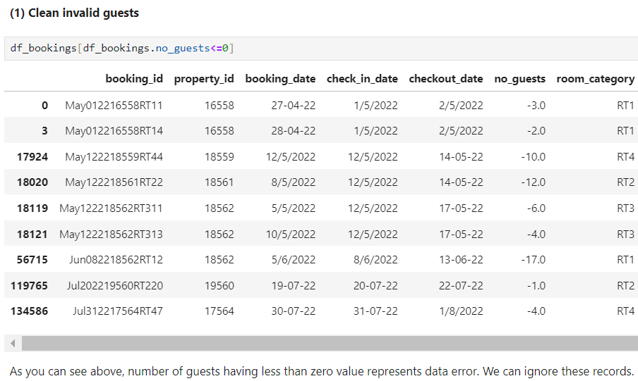
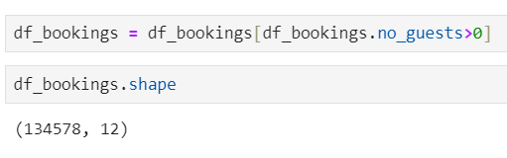
4
Exploratory Data Analysis
Check how many negative values are available in df_bookings data frame.
12 records are having negative values, and it is a data error, and it can be removed.
After removing the negative values now, the data frame has “134578” rows, This is how you can cleanup unwanted data and create the errorless data frame.
4

Slide 10
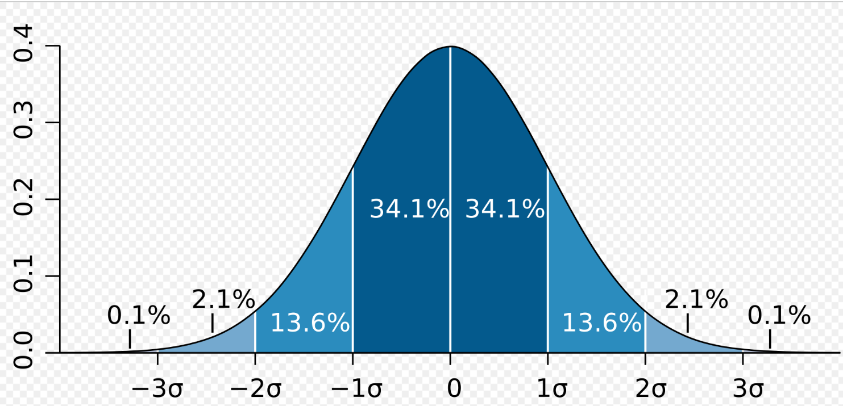
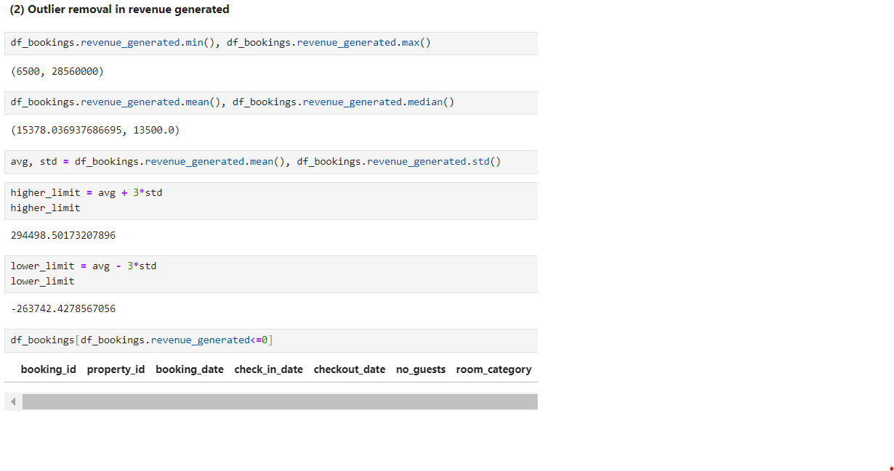
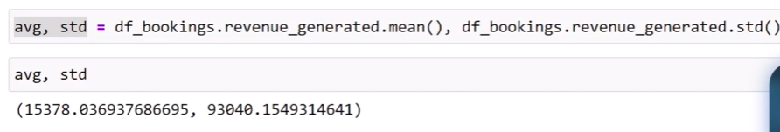
4
Exploratory Data Analysis
Outlier removal by using 3 standard deviation technique. If value is greater than 3 standard deviation, then it can be considered as an Outlier, Here Higher limit is “2,94,498” , so definitely “ “2,85,60,000” is an outlier and it has to be removed in revenue generated column.
We also know that revenue generated cannot be negative, so there are now negative records.
4

Slide 11
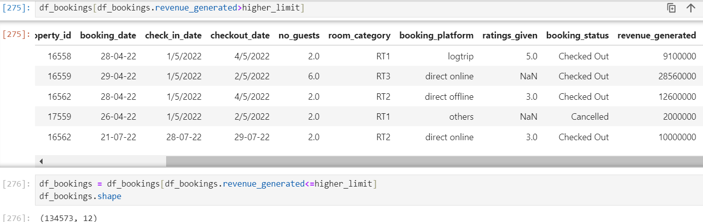
4
Exploratory Data Analysis
5 rows with greater than higher limit was available in the revenue generated column, and it was removed by modifying the data frame.
After removing the data errors now the df_bookings is having “134573” rows.
4

Slide 12
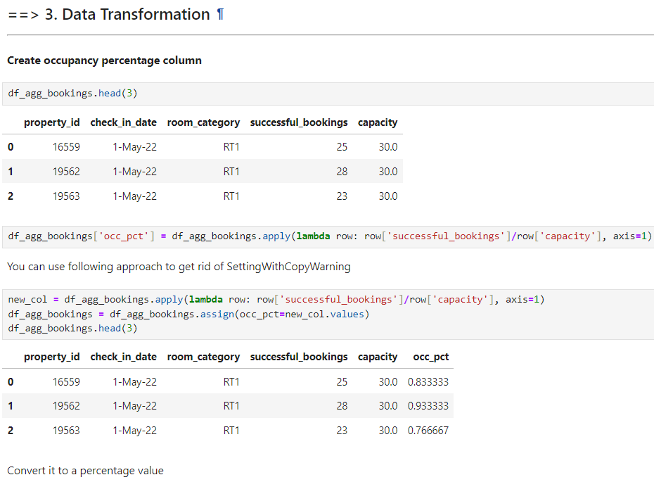
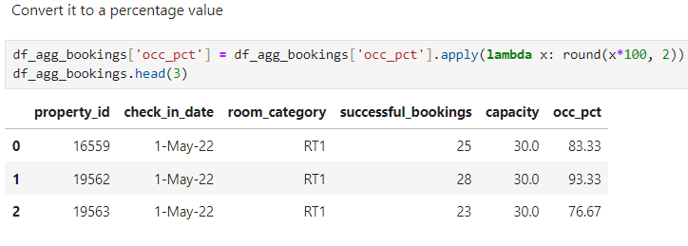
5
Data Transformation & Modelling
There are various types of data transformations that you may have to perform based on the need.
Few examples of data transformations are,
Creating new columns
Normalization
Merging data
Aggregation
5

Slide 13
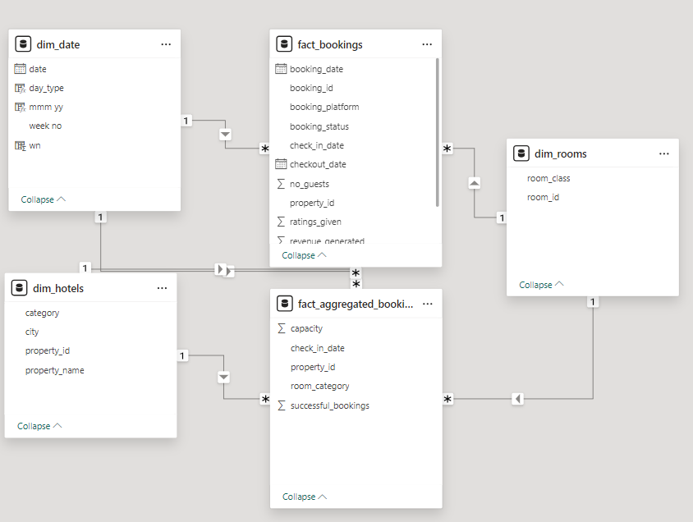
5
Data Transformation & Modelling
Star Schema Data Modelling
5

Slide 14
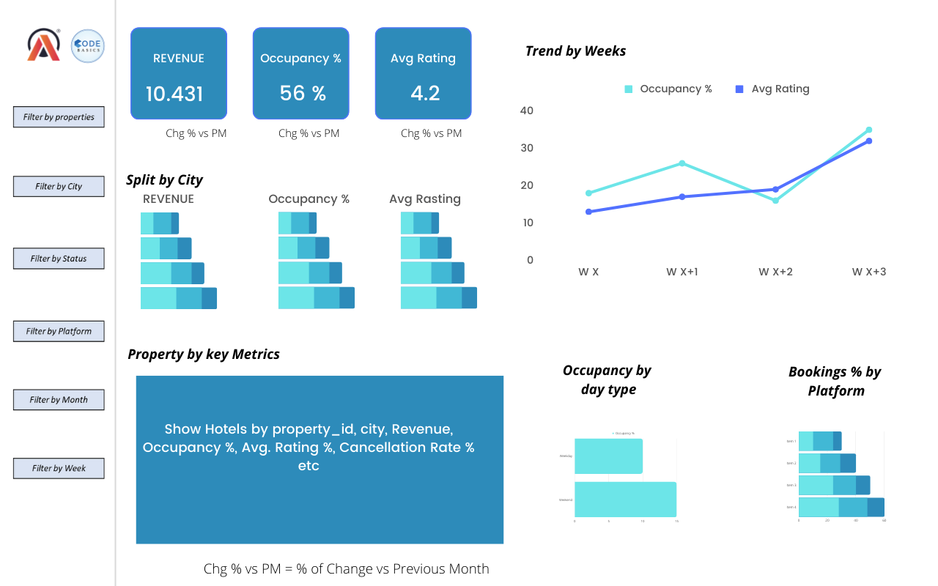
6
Mock-up Dashboard
6

Slide 15
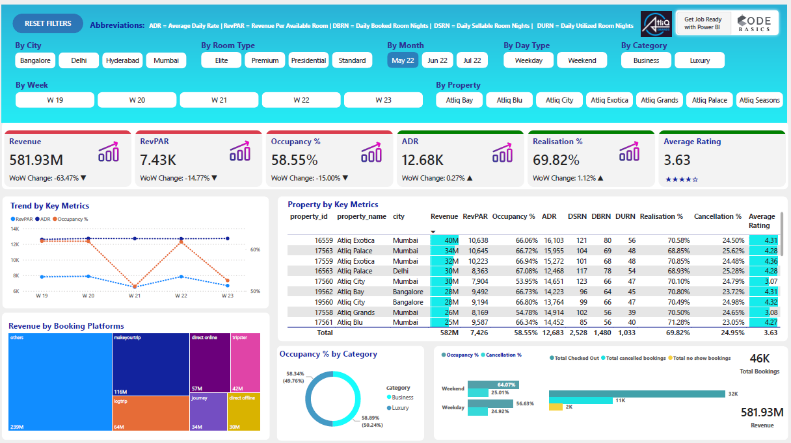
Power BI – Hospitality Main View
May 22 - Statistics
“May 2022” month data analysis are mentioned below.
Revenue generated is 582 M.
Average Revenue per available room is 7.43K.
Occupancy % is very low at around 58.55% need to be improved
Average daily rate is 12.68K is constant it should be changed on Weekends to generate more revenue
Realisation % is 69.82%
Average Rating is only 3.63 need to be improved.
DSRN is 2,528.
DBRN is 1,480.
DURN is only 1,033 , so daily utilized rooms are very less because of less Occupancy % and cancellation % is also around 25 %, it must be reduced
Make your trip is one of the booking platform which is contributing around 19-20% to the revenue .
However major revenue around 40% is coming from unrecognized sources which needs to identified for better marketing efforts.
Naturally on Weekend’s the Occupancy % is 64.07% compared to Weekday’s i.e., 56.63%
7
7

Slide 16
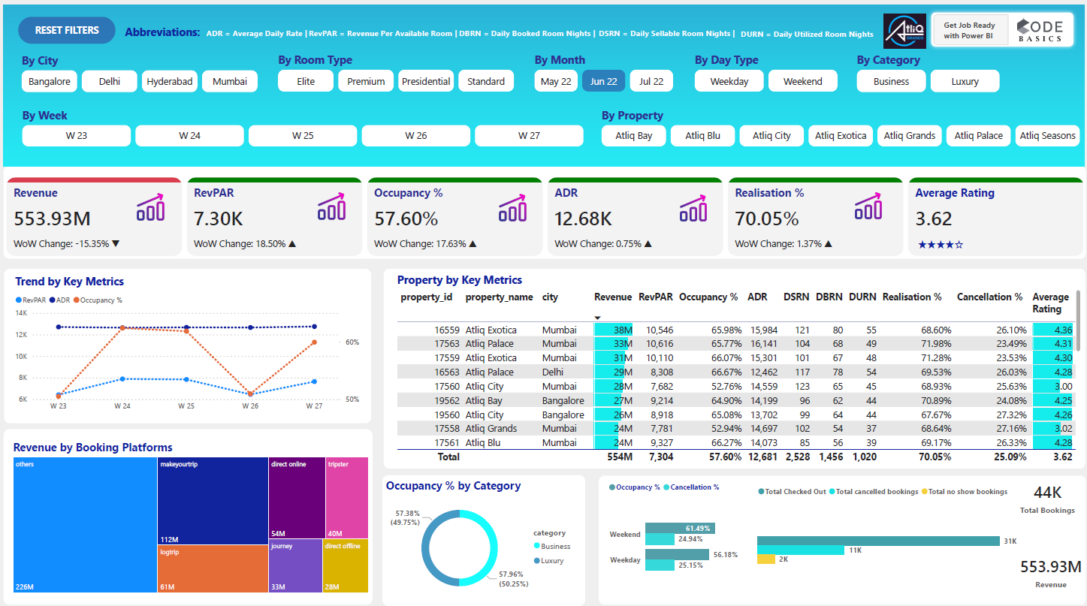
Power BI – Hospitality Main View
Jun 22 - Statistics
“Jun 2022” month data analysis are mentioned below.
Revenue generated is 554 M.
Average Revenue per available room is 7.30K
Occupancy % is very low at around 57.60% need to be improved
Average daily rate is 12.68K is constant it should be changed on Weekends to generate more revenue
Realisation % is 70.05%
Average Rating is reduced to 3.62 compared to May month. need to be improved.
DSRN is 2,528.
DBRN is 1,480.
DURN is only 1,020 again reduced , so daily utilized rooms are very less because of less Occupancy % and cancellation % is also around 25 %, it must be reduced
Make your trip is one of the booking platform which is contributing around 19-20% to the revenue .
However major revenue around 40% is coming from unrecognized sources which needs to identified for better marketing efforts.
Naturally on Weekend’s the Occupancy % is 61.49% compared to Weekday’s i.e., 56.18%.
7
7

Slide 17
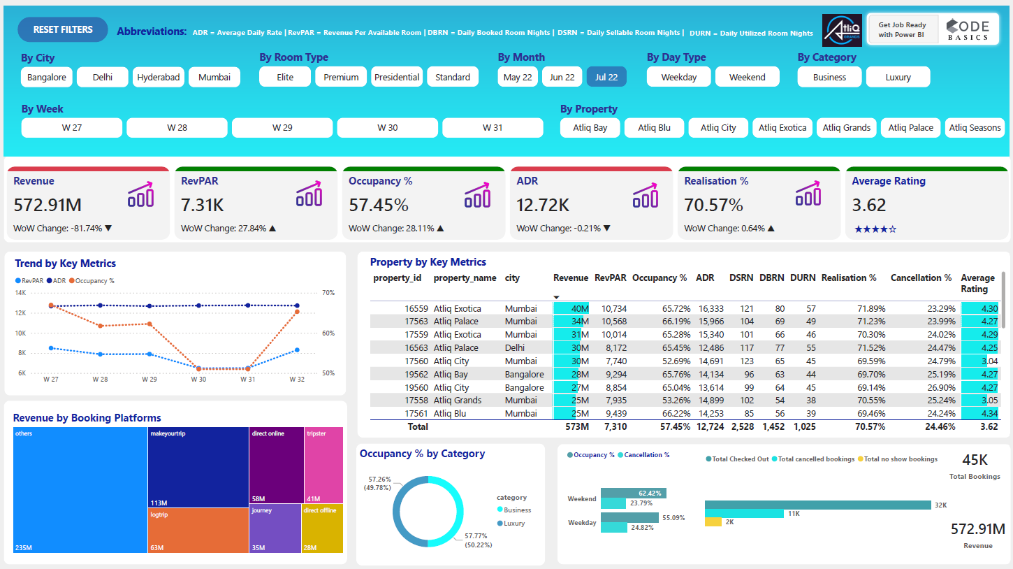
Power BI – Hospitality Main View
Jul 22 - Statistics
“Jul 2022” month data analysis are mentioned below.
Revenue generated is 573 M.
Average Revenue per available room is 7.31K
Occupancy % is very low at around 57.45% need to be improved
Average daily rate is 12.72K is constant it should be changed on Weekends to generate more revenue
Realisation % is 70.57%
Average Rating is reduced to 3.62 compared to May month. need to be improved.
DSRN is 2,528.
DBRN is 1,452.
DURN is only 1,025 again reduced , so daily utilized rooms are very less because of less Occupancy % and cancellation % is also around 25 %, it must be reduced
Make your trip is one of the booking platform which is contributing around 19-20% to the revenue .
However major revenue around 40% is coming from unrecognized sources which needs to identified for better marketing efforts.
Naturally on Weekend’s the Occupancy % is 62.42% compared to Weekday’s i.e., 55.09%.
7
7

Slide 18
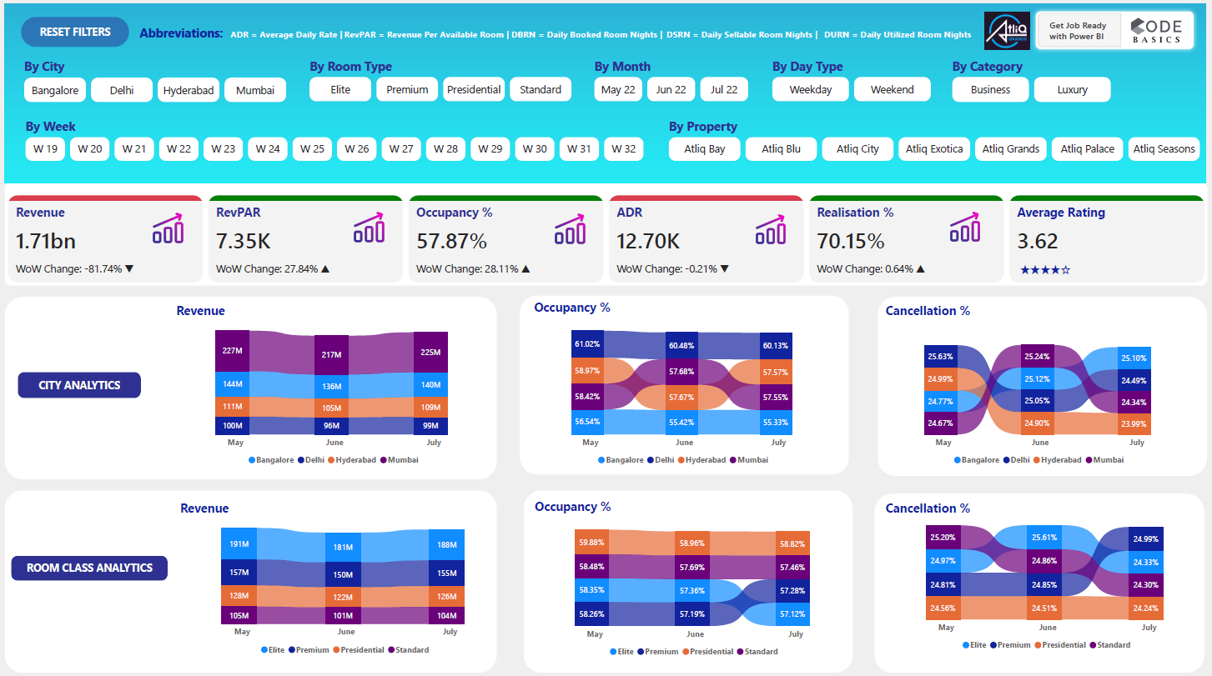
8
Performance Analytics
City & Room Class Analytics
City Wise Analytics:
Revenue: In revenue generation Mumbai is in 1st place irrespective of all the months and 2nd place goes to Bangalore & Last place goes to Delhi.
Occupancy % : Delhi is leading in 1st position and Bangalore is in last position.
Cancellation %: Delhi is having more cancellation% of 25.63% compared to other cities
Room Class Analytics:
Revenue: Elite is in the first place in contributing the revenue and the last place goes to standard room class.
Occupancy % : Presidential Suite is having highest occupancy % compared to others.
Cancellation %: Elite is having more cancellation% of 25.61% compared to other room types.
7

Slide 19
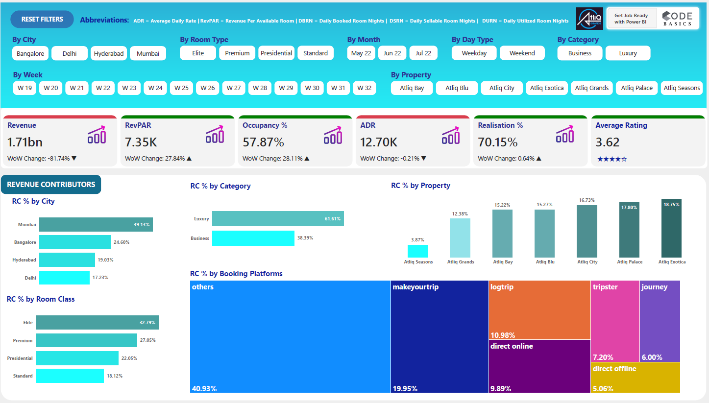
9
Revenue Contributors
Revenue Contributors:
RC % by City : Mumbai is in 1st place with RC % of 39.13% by generating revenue irrespective of all the months and 2nd place goes to Bangalore & Last place goes to Delhi.
RC % by Room Type : Elite is in 1st place with RC % of 32.73%
RC % by Category: Luxury Category is in first place by generating 61.61% of revenue compared to Business category.
RC % by Booking Platforms:
Make your trip is one of the booking platform which is contributing around 19-20% to the revenue .
However major revenue around 40% is coming from unrecognized sources which needs to identified for better marketing efforts.
RC % by Property:
AtliQ Exotica is in 1st place with RC % of 18.75% and 2nd place goes to AtliQ Palace with RC% of 17.80%
AtliQ Seasons is the worst performing property with rating 2.29 & RC % is 3.87%
7

Slide 20
10
Insights Summary
Revenue Insights Summary:
Revenue by Month Wise:
In May 2022, Revenue generated is 582 M which is more compared to other months. June 2022 – 554 M and July 2022 – 573 M
RC % by City : Mumbai is in 1st place with RC % of 39.13% by generating revenue irrespective of all the months and 2nd place goes to Bangalore & Last place goes to Delhi.
RC % by Room Type : Elite is in 1st place with RC % of 32.73%
RC % by Category: Luxury Category is in first place by generating 61.61% of revenue compared to Business category.
RC % by Booking Platforms:
Make your trip is one of the booking platform which is contributing around 19-20% to the revenue .
However major revenue around 40% is coming from unrecognized sources which needs to identified for better marketing efforts.
RC % by Property:
AtliQ Exotica is in 1st place with RC % of 18.75% and 2nd place goes to AtliQ Palace with RC% of 17.80%
AtliQ Seasons is the worst performing property with rating 2.29 & RC % is 3.87%
7

Slide 21




THANK YOU
Mr. DHAVAL PATEL
Mr. HEMANAND VADIVEL

